Slide 1
Divide and Conquer
Tasmin Sanjida
United International University

Slide 2
Divide and Conquer
The Divide and Conquer algorithm is a problem-solving method that breaks a problem into smaller, more manageable subproblems.
It works by recursively dividing the main problem into smaller parts, solving them independently, and then combining their solutions to address the original problem.
The basic steps of the Divide and Conquer algorithm are:
Divide: Break the problem into smaller subproblems.
Conquer: Solve the subproblems recursively.
Combine: Combine the solutions of the subproblems to solve the original problem.
The base case for the recursion is subproblems of constant size

Slide 3
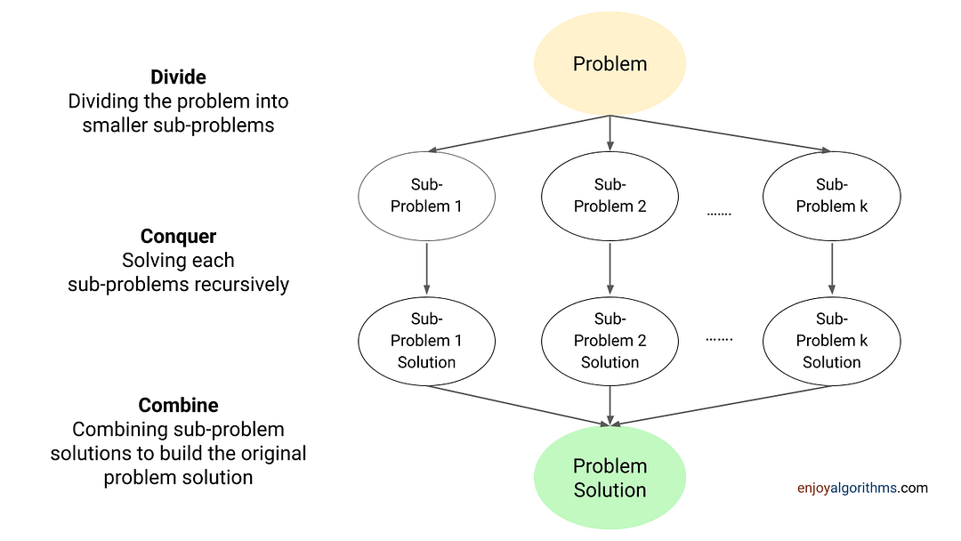
Divide and Conquer

Slide 4
Divide and Conquer
div_conquer(problem){
if(small(problem)){
solve(problem)
}
else{
Divide problem into problem1, problem2,.....,problemk
Apply div_conquer(problem1), div_conquer(problem2),...
Combine(div_conquer(problem1), div_conquer(problem2),...)
}
}

Slide 5
Divide and Conquer
Max-Min Problem
Maximum Sum Subarray
Binary Search
Quick Sort
Merge Sort
strassen's matrix multiplication
And many problems can be solved using divide and conquer

Slide 6
Problem 1
Find the count of even numbers in an array Arr of N integers
Sample Input | Sample Output
7 1 7 8 10 3 4 2 | 4

Slide 7
1. Find the count of even numbers in an array Arr of N integers
First, define the function similar to following
int countEven( int Arr[], int i, int j ) {
}

Slide 8
1. Find the count of even numbers in an array Arr of N integers
Second, identify the base case. A base case is the given problem in a smaller size such that it can be solved without any computation.
int countEven( int Arr[], int i, int j ) {
if (i==j) // array size 1
{
if ( Arr[i] % 2 == 0 ) return 1;
else return 0;
}
}

Slide 9
1. Find the count of even numbers in an array Arr of N integers
Next, for solving the problem when the base case scenario does not occur, suppose if you already know the solution of a problem of size N/2. Now, can you find the solution of a bigger problem of size N?
Question: How can we actually know the count of even numbers in the first half and the second half? (Divide and Conquer)
Answer: Using recursion

Slide 10
1. Find the count of even numbers in an array Arr of N integers
int countEven( int Arr[], int i, int j ) {
if (i==j) { // array size 1
if ( Arr[i] % 2 == 0 ) return 1;
else return 0;
} else {
int mid = (i+j)/2;
int c1 = countEven(Arr, i, mid); // solution to the first half
int c2 = countEven(Arr, mid+1, j); // solution to the second half
}
}

Slide 11
1. Find the count of even numbers in an array Arr of N integers
Now, you just have to combine the solutions together
int countEven( int Arr[], int i, int j ) {
if (i==j) { // array size 1
if ( Arr[i] % 2 == 0 ) return 1;
else return 0;
} else {
int mid = (i+j)/2;
int c1 = countEven(Arr, i, mid); // solution to the first half
int c2 = countEven(Arr, mid+1, j); // solution to the second half
return c1+c2;
}}

Slide 12
Problem2. X^{Y}
Write a program that takes X and Y as input and calculates the value of X^Y using divide and conquer and prints it.
Sample Input | Sample Output
3 7 | 2187

Slide 13
2. X^{Y}
power(x, n) = power(x, n / 2) * power(x, n / 2); // if n is even
power(x, n) = x * power(x, n / 2) * power(x, n / 2); // if n is odd
long long power(int x, int y){
if (y==0) {
return 1;
} else {
int mid = y/2;
long long p = power(x, mid);
if (y%2==0) { // power even
return p*p;
} else {
return p*p*x; }}}

Slide 14
Problem 3
Find the max and min element of an array.
Sample Input | Sample Output
7 1 7 8 10 3 4 2 | Max: 10 min: 1

Slide 15
3. Find the max and min element of an array.
Write a program that does the following
Take N numbers as input and store them in an array A
Write a function findMaxMin that returns the maximum and minimum elements of an array using divide and conquer.
Use the function findMaxMin to print the maximum and minimum elements of the array A

Slide 16
3. Find the max and min element of an array.
Divide and Conquer :
Function RMaxMin(A, i, j):
if i==j then
return A[i], A[i] //Base case
else
mid = (i+j)/2
max1, min1 = RMaxMin(A, i, mid) //Divide
max2, min2 = RMaxMin(A, mid+1, j) //Divide
fmax = max(max1, max2)
fmin = min(min1, min2)
end if
return fmax, fmin

Slide 17
Problem 4
Write a function binarySearch that finds the index of an element KEY in a sorted (ascending) array A of N integers using divide and conquer. If the element KEY is not present in the array, return -1.
Write a main that takes the array A and an integer KEY as input from the user in a sorted way. Find the index of KEY in A using the function binarySearch and print it.
Sample Input | Sample Output
5 1 5 7 9 10 Key: 9 | Found at 4 no position

Slide 18
Binary Search
Binary search is a search algorithm commonly used in computer science to efficiently locate a target value within a sorted sequence, such as an array or a list.
The basic idea behind binary search is to repeatedly divide the search space in half, narrowing down the possible locations of the target value until it is found.

Slide 19
4. Binary Search
Note that the following pseudocode assumes that the array is sorted in ascending order.
Function BinarySearch( Array,start, end, key) {
if start==end then
if key== A[start] then return start
else return NOT_FOUND
else
mid = (start+end)/2
if key == A[mid] then return mid
else if key < A[mid] then
return BinarySearch(A, start, mid-1, key)
else // if key > A[mid]
return BinarySearch(A, mid+1, end, key)
end if
}

Slide 20
4. Binary Search
Function BinarySearch( Array,start, end, key) {
if start==end then
if key== A[start] then return start
else return NOT_FOUND
else
mid = (start+end)/2
if key == A[mid] then return mid
else if key < A[mid] then
return BinarySearch(A, start, mid-1, key)
else // if key > A[mid]
return BinarySearch(A, mid+1, end, key)
end if }

Slide 21
Problem 5
Write a function mergeSort that sorts an array of N numbers using merge sort.

Slide 22
Merge Sort
mergeSort(arr, left, right)
if left < right
middle = left + (right - left) / 2
mergeSort(arr, left, middle)
mergeSort(arr, middle + 1, right)
merge(arr, left, middle, right)

Slide 23
Merge Sort
merge(arr, left, middle, right) n1 = middle - left + 1 n2 = right - middle leftArray[n1], rightArray[n2] for i = 0 to n1 leftArray[i] = arr[left + i] for j = 0 to n2 rightArray[j] = arr[middle + 1 + j] i = 0, j = 0, k = left | while i < n1 and j < n2 if leftArray[i] <= rightArray[j] arr[k] = leftArray[i] i++ else arr[k] = rightArray[j] j++ k++ while i < n1 arr[k] = leftArray[i] i++ k++ while j < n2 arr[k] = rightArray[j] j++ k++

Slide 24
Problem 6
Find the max sum of subarray.
Sample Input | Sample Output
7 1 2 -3 4 5 | 9

Slide 25
6. Find the max sum of subarray.
int maxSumSubArray( int Arr[], int i, int j ) {
if (i==j) {
return arr[i];
} else {
int mid = (i+j)/2;
return max(maxSumSubArray(arr, low, mid)
maxSumSubArray(arr, mid + 1, high)
maxCrossingSum(arr, low, mid, high))
}}

Slide 26
6. Find the max sum of subarray.
maxCrossingSum(arr, low, mid, high){
leftSum = INT_MIN, rightSum = INT_MIN
for low to mid
sum += arr[low];
leftSum=max(leftSum, sum)
for mid to high
sum += arr[mid];
rightSum=max(rightSum, sum)
return leftSum + rightSum;
}

Slide 27
Practice Problem
Quick Sort
Merge Sort
Searching

Slide 28
More practice problems
C/C++ Divide and Conquer Programs - GeeksforGeeks (Practice only Easy and Medium problems)

